Slide 1
Determining Risk Factors for Cardiovascular Heart Disease
Team Members -
Sanhita Bhagwat
Sampada Chavan
Hrudaya Reddy
Rishi Savla

Slide 2
Introduction
Cardiovascular disease kills 30% of people worldwide. Understanding cardiovascular disease risk factors is crucial for improving preventive measures.
The main objective of this project is to determine which numeric variable is more important in determining CVD
Cardiovascular disease is a serious health issue with significant mortality rates.
Identifying risk factors and their relationships can help in designing better preventive measures.
2

Slide 3
Introduction
Project Objective : To determine how particular demographic elements, healthy lifestyle choices, and biological indicators influence the development of heart disease.
Key Risk Factors: Smoking, high blood pressure, and high cholesterol are known risk factors for cardiovascular disease.
Expected Outcome: By identifying risk factor patterns and their relationships with cardiovascular disease, personalized interventions can be developed to target individual risk factors.
Methodology: This project will utilize modern machine learning techniques to analyze this dataset.

Slide 4
Why we choose this Dataset ?
Significance of cardiovascular disease:
Cardiovascular disease is a leading cause of morbidity and mortality globally, necessitating a deeper understanding of its risk factors.
By studying this dataset, we aim to explore the potential relationships between various risk factors and the development of cardiovascular disease.
Research potential and implications:
Analyzing this dataset using modern machine learning techniques can provide valuable insights into the relationships between risk factors and cardiovascular disease.
The findings can contribute to improved understanding, early detection, and the design of effective preventive measures.

Slide 5
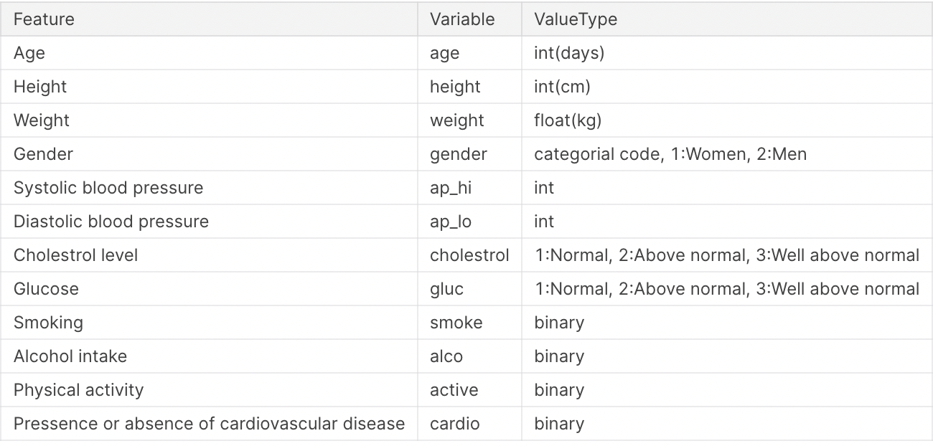
Data Description
Dataset includes attributes such as age, gender, height, weight, blood pressure values, cholesterol levels, glucose levels, smoking habits, alcohol consumption, physical activity, and the presence or absence of cardiovascular disease.
5

Slide 6
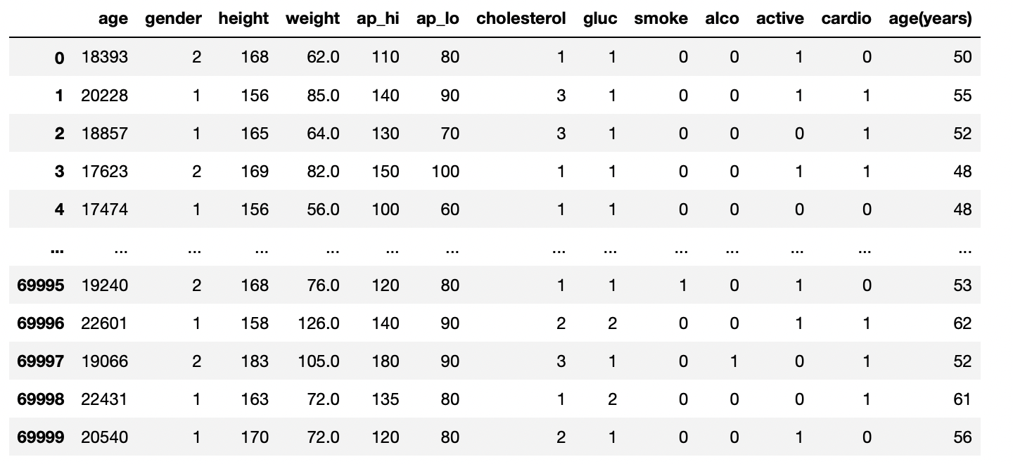
Data Cleaning
Age transformation: We converted the age variable from days to years for better interpretability.
Duplicate removal: We removed any duplicate entries to maintain data integrity.
Missing value handling: We dropped any rows with missing values to ensure valid analysis.
6

Slide 7
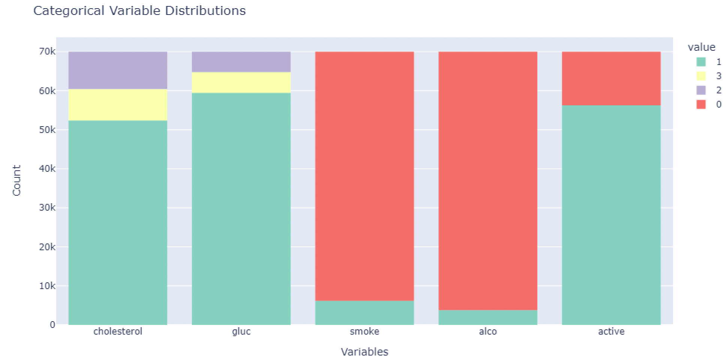
Data Visualization - Variable Distributions
Using this graph, we analyzed that how the data is distributed in the dataset
7

Slide 8
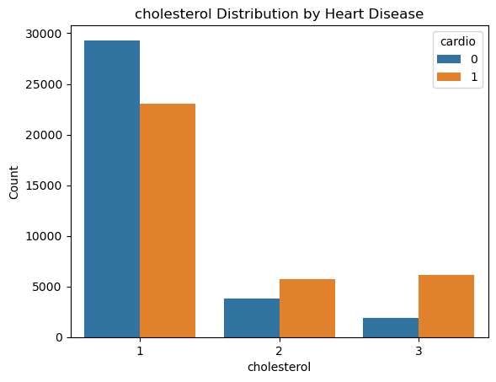
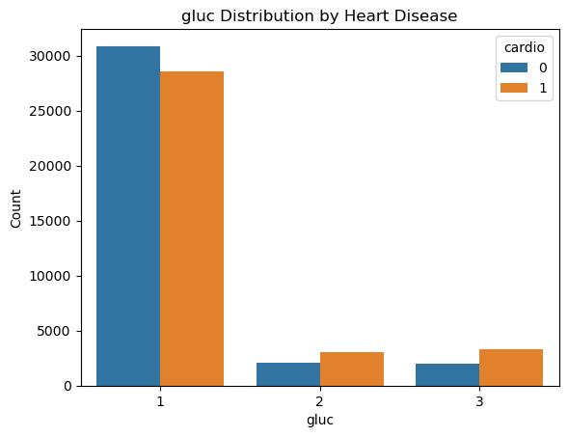
Data Visualization - Variable Distributions
These are the two variables for which presence or absence of cardiovascular disease is not evenly distributed
8

Slide 9
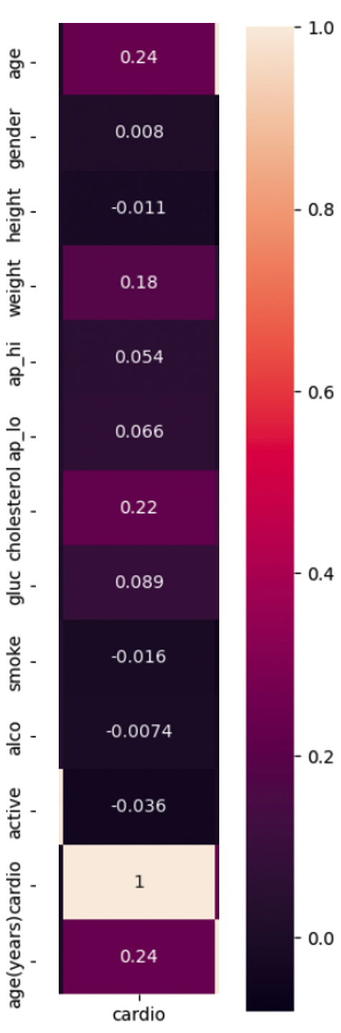
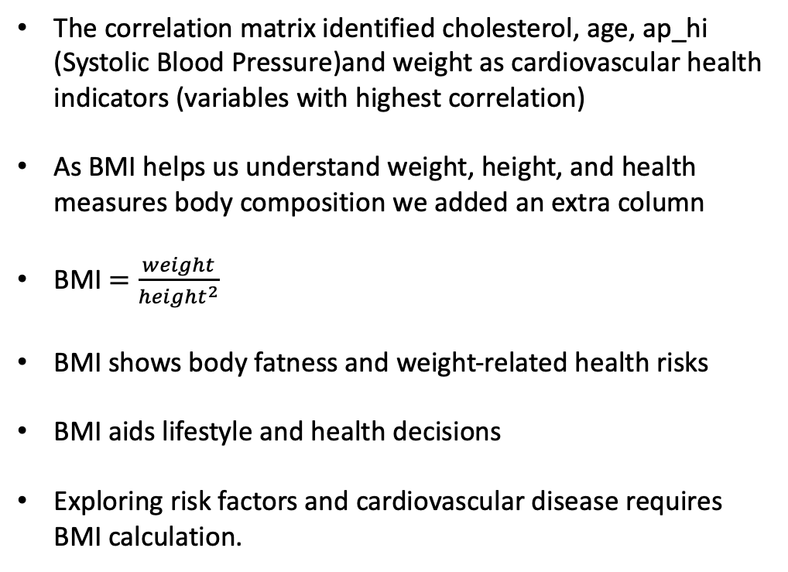
Calculation of Body Mass Index (BMI)
The correlation matrix identified cholesterol, age, ap_hi (Systolic Blood Pressure)and weight as cardiovascular health indicators (variables with highest correlation)
As BMI helps us understand weight, height, and health measures body composition we added an extra column
BMI $=\frac{weight}{{height}^{2}}$
BMI shows body fatness and weight-related health risks
BMI aids lifestyle and health decisions
Exploring risk factors and cardiovascular disease requires BMI calculation.

Slide 10
Decision Tree Classifier
A decision tree classifier predicted cardiovascular disease using selected features.
Age, BMI, glucose, cholesterol, systolic blood pressure (ap_hi), and diastolic blood pressure (ap_lo) were used to predict.
The train dataset decision tree model had 72.5% classification accuracy.
The decision tree model classified 72.8% of the test dataset.
Confusion matrices show decision tree model performance on train and test datasets.

Slide 11
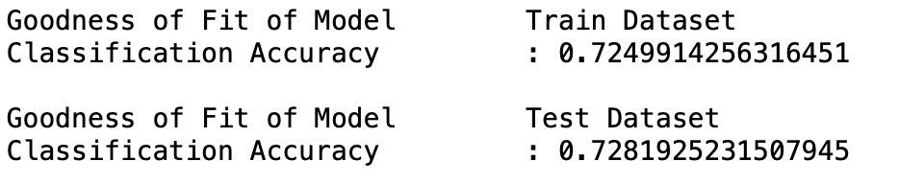
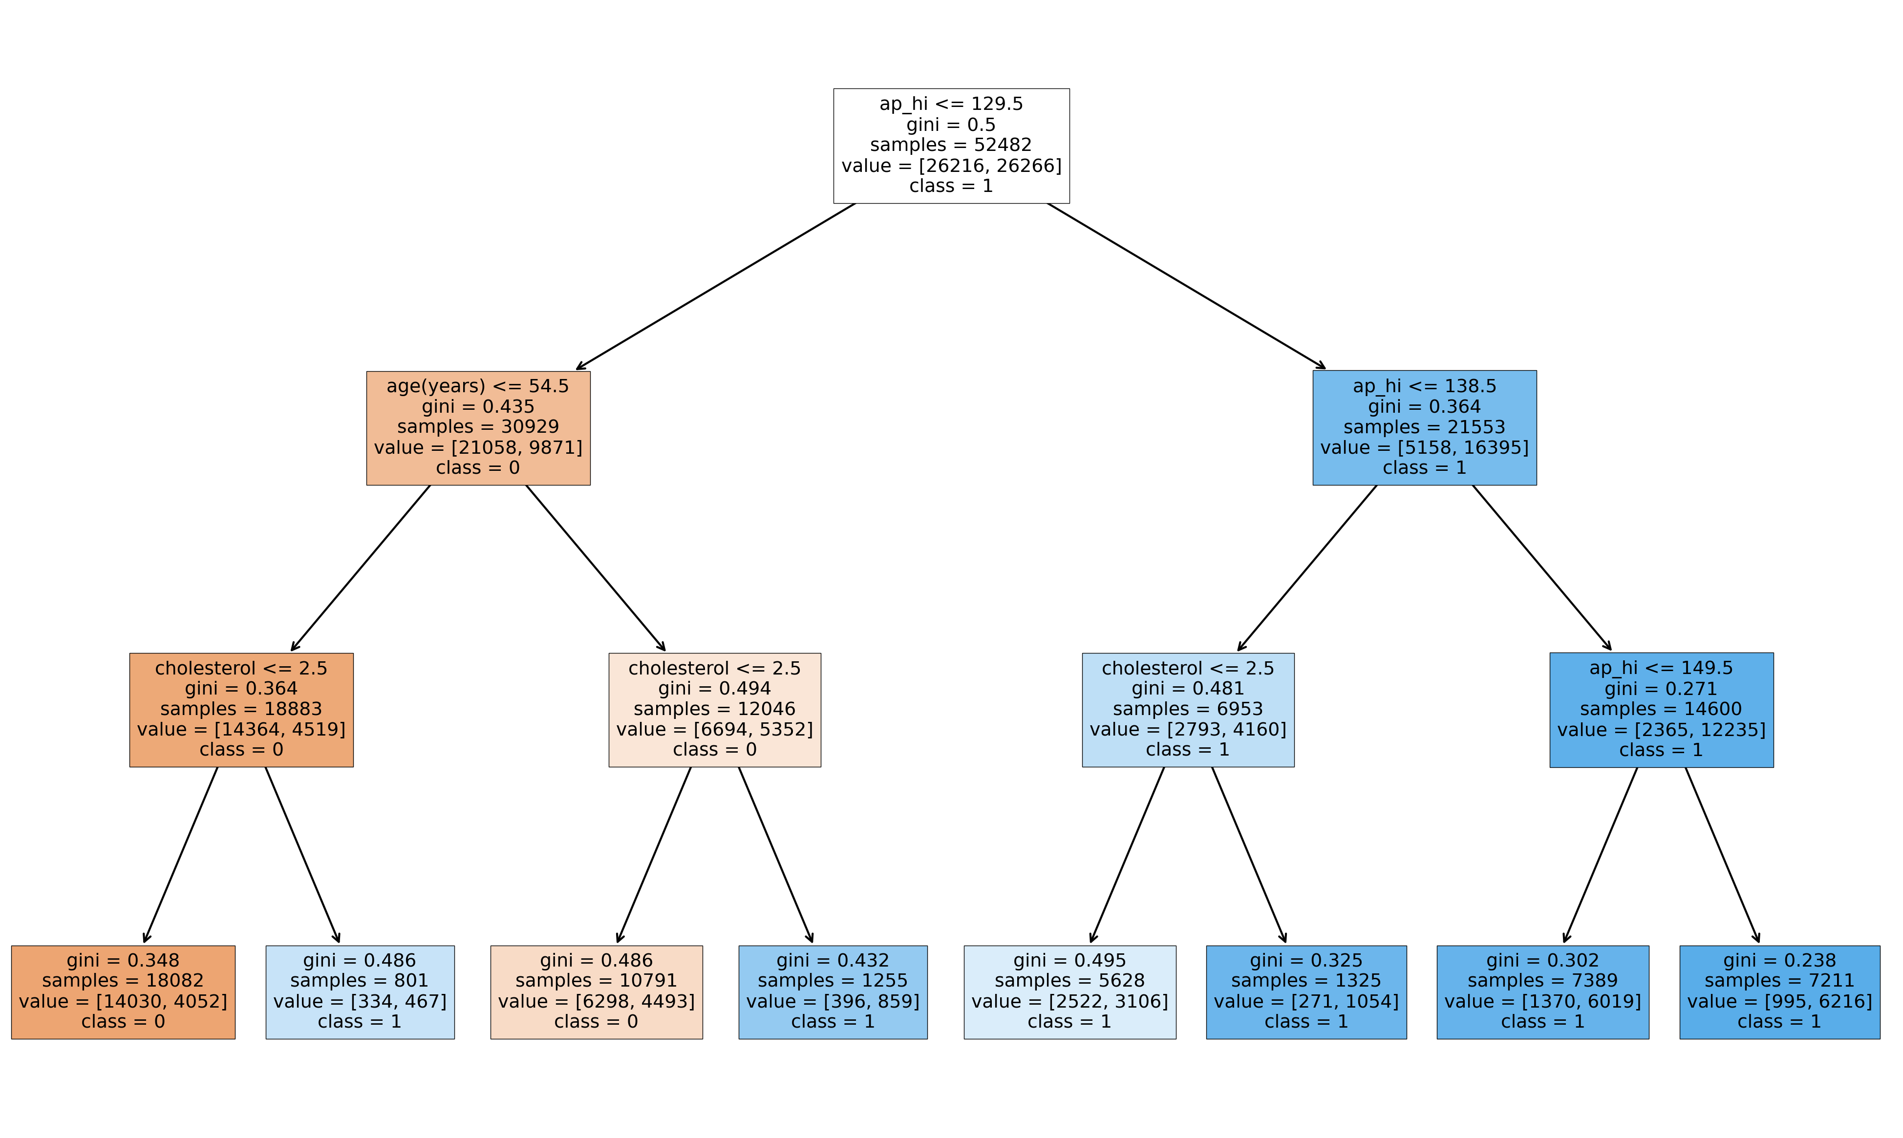
Decision Tree Classifier

Slide 12
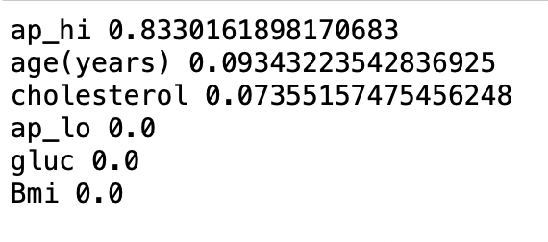
Determining which Numeric Variable is most important in determining CVD
Systolic Blood pressure, age and cholesterol were identified as the most important variables for this analysis

Slide 13
Random Forest Classifier
The decision tree classifier determined each numeric variable's cardiovascular disease prediction value.
Systolic blood pressure (ap_hi), age (in years), and cholesterol level were the most important factors in cardiovascular disease, according to feature importance analysis.
Diastolic blood pressure (ap_lo), glucose, and BMI were less important predictors.
The random forest model classified the train dataset 85.8% accurately.
The random forest model classified the test dataset at 57.6%.

Slide 14
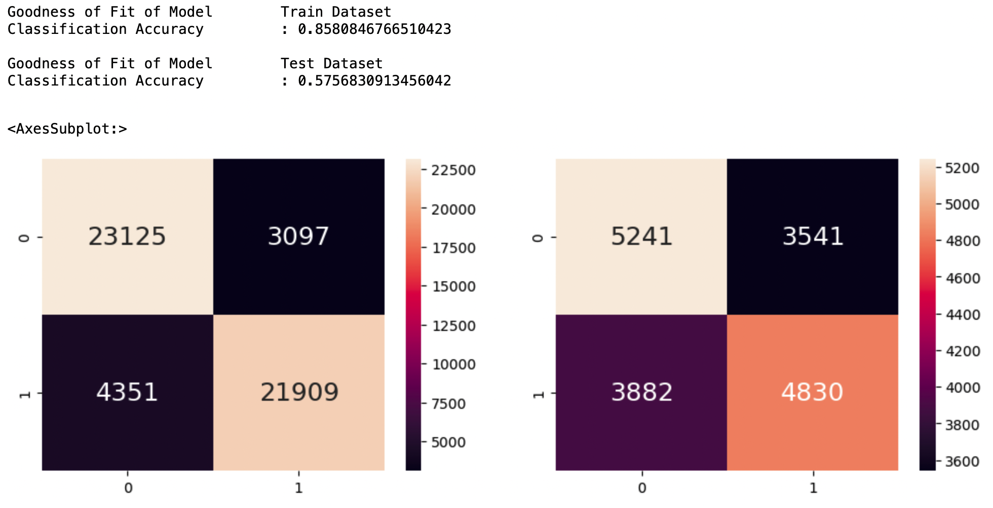
Random Forest Classifier

Slide 15
Model Comparison and Conclusion
The decision tree classifier had lower classification accuracy than the random forest classifier.
The decision tree model achieved an accuracy of approximately 72.8% , while the random forest model achieved an accuracy of approximately 85.08%.
The random forest model considers the ensemble of decision trees and can handle a larger number of features effectively, resulting in improved performance.

